Slide 1
Stage 3: Melting Materials

Slide 2
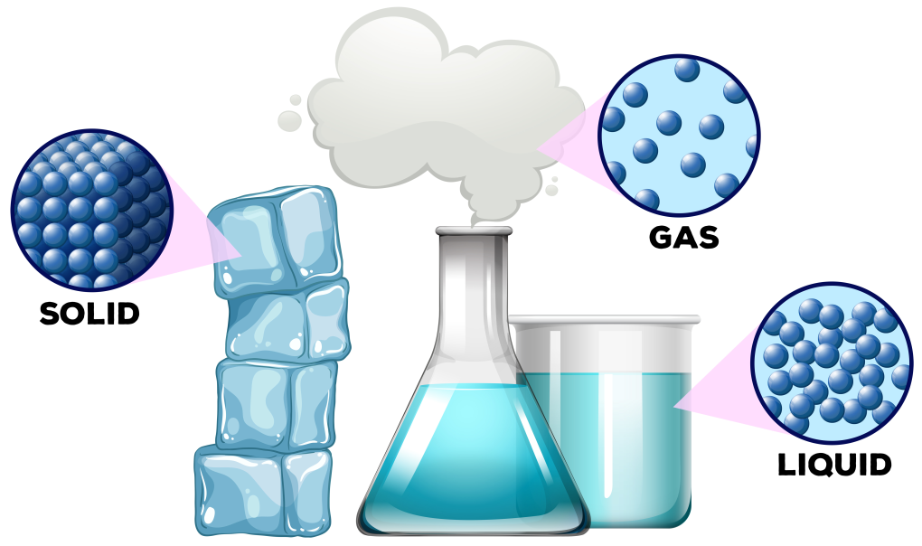
States of matter
All materials are solids, liquids or gases.
Can you think of any examples of any solids, liquids or gases?

Slide 3
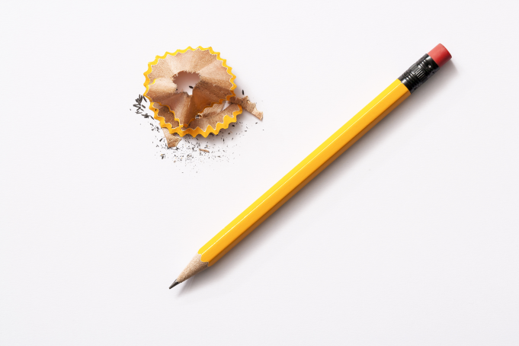
Solids
Solids can be held and do not change shape or flow like liquids.
They always take up the same amount of space and do not spread out like gases.
They can be shaped or cut.

Slide 4
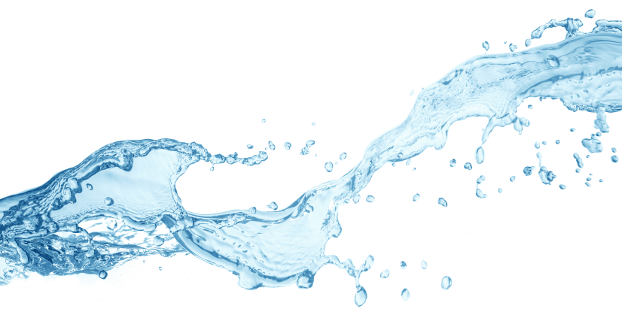
Liquids
Liquids cannot be held easily.
They can flow and change their shape depending on the container that they are in.
They always take up the same amount of space.

Slide 5
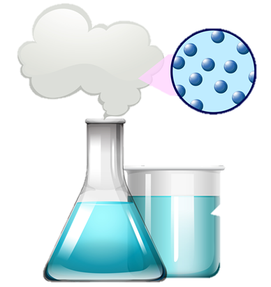
Gases
Gases do not have a fixed shape and can spread out to fill up whatever container they are in.
They are often invisible.

Slide 6
Sometimes materials change state
A reversible or physical change is a change that can be undone or reversed so that you can get back the substances you started with.
Can you think of an example of a physical change?

Slide 7
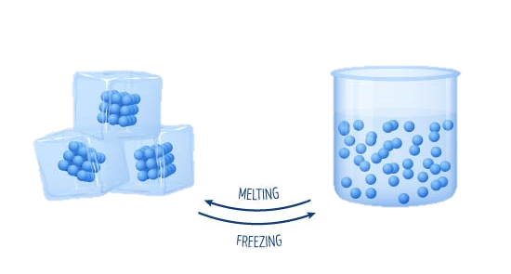
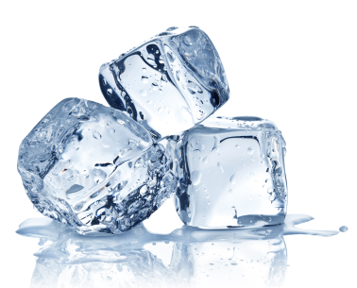
A reversible change
solid
liquid
gas
ice
water
water vapour

Slide 8
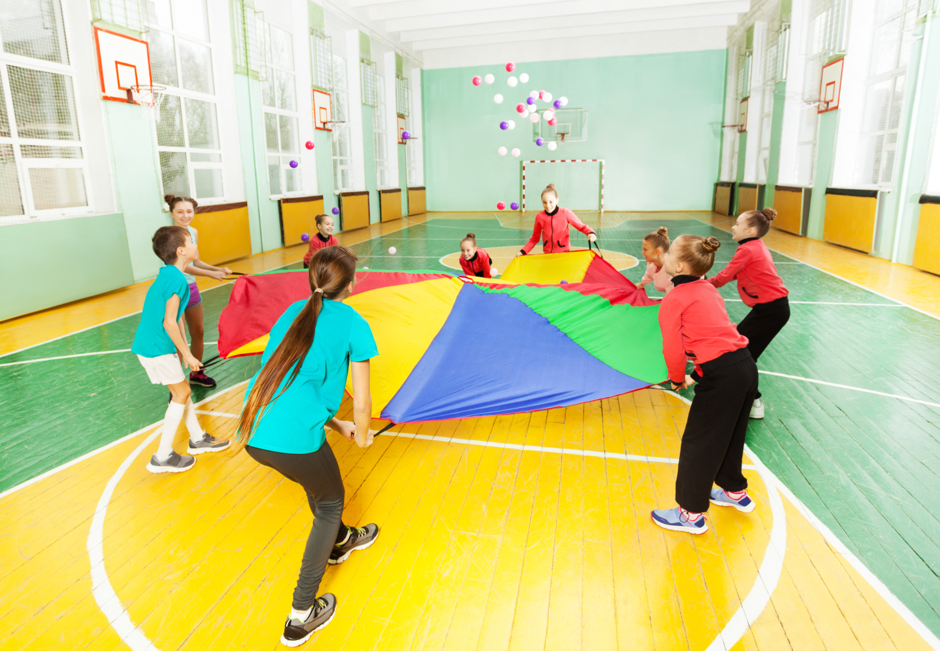
Changes of state

Slide 9
Learning Objectives:
• To design and conduct a fair investigation
• To observe that some materials change state when they are heated and measure the temperature at which this happens in degrees Celsius (°C)
We are going to be designing a fair investigation to find out the temperature at which butter and ice cream (dairy products) fully change state.
Talk to your group: how could we do this? What would we measure?

Slide 10
Carrying out a fair test
A fair test is a controlled investigation that compares two things. In order for a test to be fair or well controlled, we have to make sure that only one thing (variable) is changed and everything else is kept the same.
A variable is anything that can affect the results we are observing or measuring.
We will be changing the type of dairy product and comparing our results.
What variables do we need to keep the same during our investigation?

Slide 11
Your tasks
Write a prediction: which dairy product do you think will take the longest to change state? Explain why you think this.
Write a paragraph to explain which variables you are going to control (keep the same) e.g. temperature of the water.
Draw a table to record your results.

Slide 12
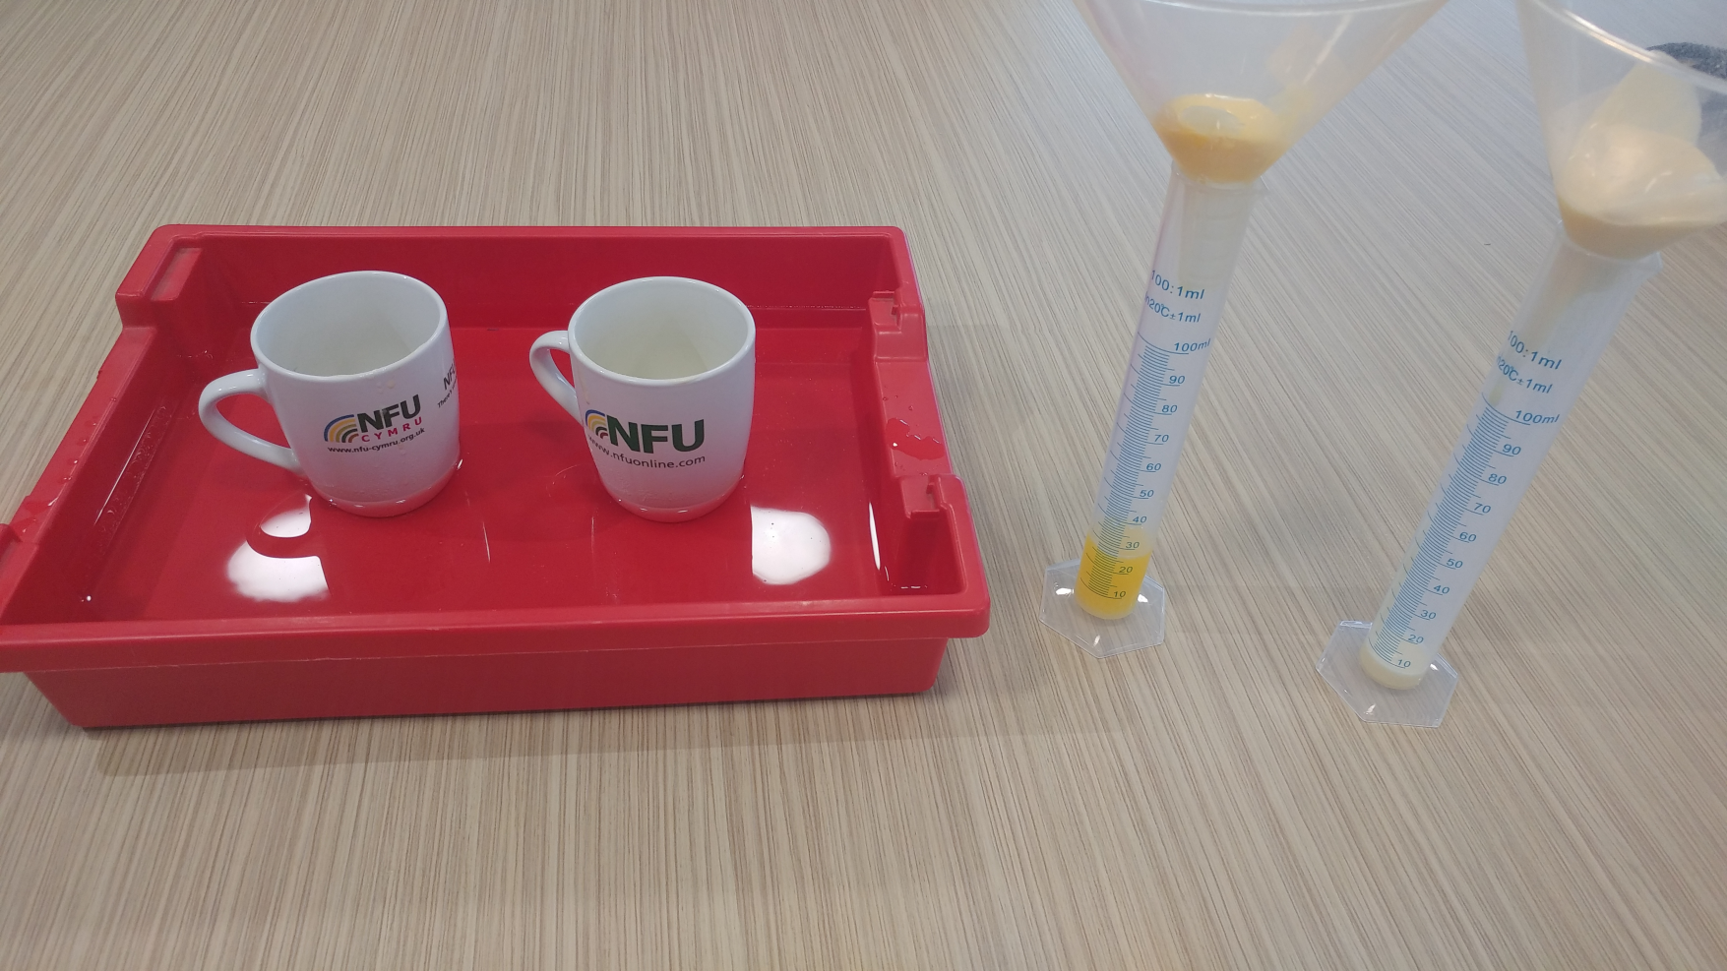
Setting up your investigation

Slide 13
Time graphs
Time graphs are line graphs that allow us to see how a variable changes over time. We will plot a graph to show how much of our solid dairy product had changed to liquid at each time interval.
Plot one line for butter and one line for ice cream
Y axis
Use a key to show which coloured line represents which dairy product
The axis scales increase in regular intervals
X axis

Slide 14
Your conclusion
Explain what you found and why you think this happens.
Explain what you have discovered about the melting point of butter and ice cream.
Why do different dairy products require different amounts of energy to change state?
Look back at your prediction- were you correct?

